Slide 1
SEARCHY
Search Engine
Manisha Pathak
Disha Bisht
Debajyoti Nag

Slide 2

What is a Search Engine???

Slide 3
INTRODUCTION
search for information on the World Wide Web.

Slide 4
HOW DOES IT WORK???

Slide 5
Search Engines operate in the following order :

Slide 6
CRAWLING

Slide 7
Crawler , web-robots ,web-spider, ants
Function –
finds ,
retrieves pages on the web and
hands them off to the indexer

Slide 8
INDEXING

Slide 9
Parse
Collect
Store

Slide 10
SEARCHING/QUERYING

Slide 11
Input-User query
They vary greatly from standard query languages, which are governed by strict syntax rules as command languages with keyword or positional parameters.--??

Slide 12
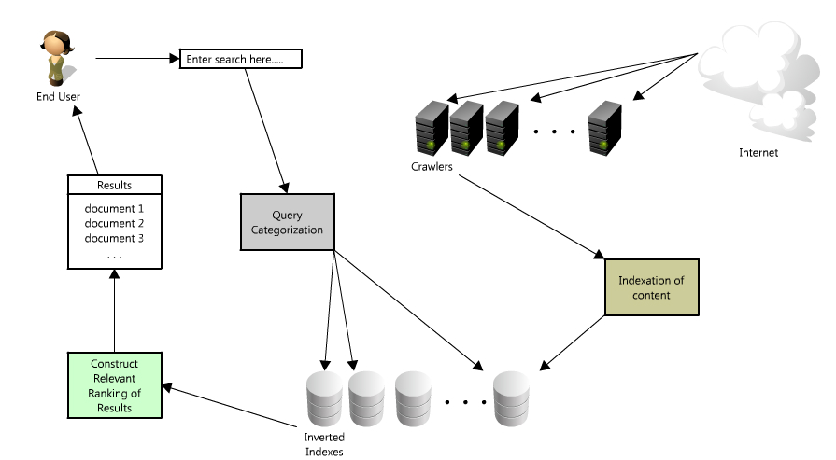
WORKING DIAGRAM

Slide 13


Slide 14
MODULES
Crawling
Tokenizer
Indexer
Look-up

Slide 15
Module 1: Web Crawler

Slide 16
Working/output

Slide 17
Module II: Tokenizer

Slide 18
Working/output

Slide 19
Module III : Indexer

Slide 20
Working/output

Slide 21
Module IV : Look-Up

Slide 22
Working/output

Slide 23
SOFTWARE USED
Python
IDLE-2.7.2
xampp Server -1.7.7
Notepad++ for html

Slide 24
THANK YOU

